Slide 1
TOWN COUNCIL SPECIAL MEETING/WORKSHOP
MAY 16, 2023 AT 6:30 PM

Slide 2
CALL TO ORDER AND OPENING CEREMONIES
Pledge of Allegiance
Invocation
Roll Call

Slide 3
DISCUSSION OF WASTEWATER TREATMENT PLANT
Review of possible new legislation
Review of preliminary system design and location
Review of Phase I cost
Review of sewer rates
Public discussion
Council discussion

Slide 4
Town of Montverde Grant Awards for Capital Projects
Grant Name | Purpose | Amount
Cares Act | PPE related to COVID | $ 185,000.00
FMIT Safety Grant | Safety upgrades to Water System | $ 2,000.00
American Rescue Plan Act of 2021 (ARPA) | Library | $ 853,956.00
American Rescue Plan Act of 2021 (Lake CO ARPA) | Wastewater | $ 5,000,000.00
Department of Environmental Protection (DEP) | Wastewater | $ 4,000,000.00
Lake County Library | Impact Fee Grant for New Library | $ 947,000.00
DEP Resiliency Grant | Stormwater | $ 1,800,000.00
State Revolving Loan Fund Wastewater Grant | Wastewater | $ 125,000.00
Lake County Water Authority | Stormwater | $ 200,000.00
SRLF Water Planning Grant/Loan | Water | $ 168,000.00
Lake County Water Authority | Boat Ramp / Water Quality Grant | $ 80,000.00
Parks - Boat Ramp | Boat Ramp / Water Quality Grant | $ 100,000.00
 |  | $ 13,460,956.00

Slide 5
Review of possible new legislation
HB 1379
Passed House unanimously on 4/26/23
Passed Senate unanimously on 5/2/23
Effective Date of July 1, 2023, if signed by the Governor
Applicable to septic systems, grease interceptors, etc.

Slide 6
Requirements applicable to the Town
5 year capital improvement element and plan must include projects to achieve pollutant load reductions
Must prioritize advanced waste treatment in Town’s Comprehensive Plan Capital Improvement Element
Must consider in its comprehensive plan the feasibility of providing sanitary sewer within 10-years including a timeline for construction of the sewer system
  Must include other details such as name and location of the facility, capacity of the sewer system and transmission facilities, projected wastewater flow at the facility for the next 20 years, expected future new construction and septic to sewer connections.

Slide 7
Deadline to amend Town’s Comprehensive Plan to address the requirements above is July 1, 2024
Due to being subject to a BMAP, annually the Town must provide FDEP with the status of construction of a sanitary sewer

Slide 8
381.0065 Onsite sewage treatment and disposal systems; regulation.—
(2) DEFINITIONS.—As used in ss. 381.0065-381.0067, the term:
(a) “Available,” as applied to a publicly owned or investor-owned sewerage system, means that the publicly owned or investor-owned sewerage system is capable of being connected to the plumbing of an establishment or residence, is not under a Department of Environmental Protection moratorium, and has adequate permitted capacity to accept the sewage to be generated by the establishment or residence; and:
1. For a residential subdivision lot, a single-family residence, or an establishment, any of which has an estimated sewage flow of 1,000 gallons per day or less, a gravity sewer line to maintain gravity flow from the property’s drain to the sewer line, or a low pressure or vacuum sewage collection line in those areas approved for low pressure or vacuum sewage collection, exists in a public easement or right-of-way that abuts the property line of the lot, residence, or establishment.
2. For an establishment with an estimated sewage flow exceeding 1,000 gallons per day, a sewer line, force main, or lift station exists in a public easement or right-of-way that abuts the property of the establishment or is within 50 feet of the property line of the establishment as accessed via existing rights-of-way or easements.
3. For proposed residential subdivisions with more than 50 lots, for proposed commercial subdivisions with more than 5 lots, and for areas zoned or used for an industrial or manufacturing purpose or its equivalent, a sewerage system exists within one-fourth mile of the development as measured and accessed via existing easements or rights-of-way.

Slide 9
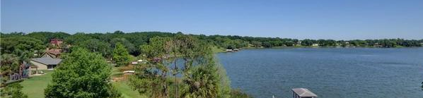

Central Sewer and Wastewater Treatment Study - UPDATE
City Council Presentation
May 16, 2023

Slide 10



Where will the money come from?
Agency | Program | Amount | Approved
 | FDEP Wastewater Grant Program | $4,000,000
 | Lake County Federal Stimulus Grant | $5,000,000
Total Received by Montverde: |  | $9,000,000
$9M in FREE state and federal grant money means NO COST for the Town and those in the served areas who volunteer to connect.
Notes:
800

Slide 11
More sewer grants are available now, but these program budgets will likely decline after three or four more years.
Agency/Program | Award/Budget Details | Montverde Potential
Lake County ARPA Grant | County has additional $8M to allocate in 2023. | $1-2 Million
FDEP Wastewater Grant | State awarded $240M in grants in January 2023, including $12M for Groveland and Mascotte. | $2-4 Million
SRF Clean Water | Current SRF Loans have potential for 30-60% principal forgiveness | $2-4 Million
St. Johns River WMD | Districtwide Cost Share Program for water quality/nutrient load reduction projects | $1-3 Million
Resilient Florida Grants | Focused on flood adaptation, including reducing water quality impacts from septic systems | $2-3 Million
FL Legislative Appropriation | State legislature provides direct funding for water quality improvement projects | $500,000
TOTAL |  | $8 - 16 Million

Slide 12
Review of
Preliminary Design

Slide 13
Potential Sewer System Layout

Slide 14
Potential Sewer System Layout

Slide 15
Potential Sewer System Layout

Slide 16
Conceptual Capital Cost Estimate

Slide 17
Anticipated Project Timeline
Secure $8M Grant Funding………………….. | COMPLETED
Hold Town Hall Meetings…………………….. | COMPLETED
Gather Community Input…………………….. | COMPLETED
Review with Town Council…………………… | COMPLETED
Develop Conceptual Plan……………………. | COMPLETED
Accept or Refuse $9M Grant……………….. | IN PROGRESS
Begin Design and Permitting………………. | May 2023
Begin Sewer System Construction………. | June 2024
Begin Connecting Properties………………. | June 2025

Slide 18
Engineering Cost Estimate

Slide 19


Town of Montverde, FL
Central Sewer System Rate Analysis
May 16, 2023
Willdan Financial Services
Jeff McGarvey, Vice President/Managing Principal
Tara Hollis, CPA, CVA, Principal Consultant

Slide 20
Town of Montverde, FL
Willdan Financial Services

Slide 21
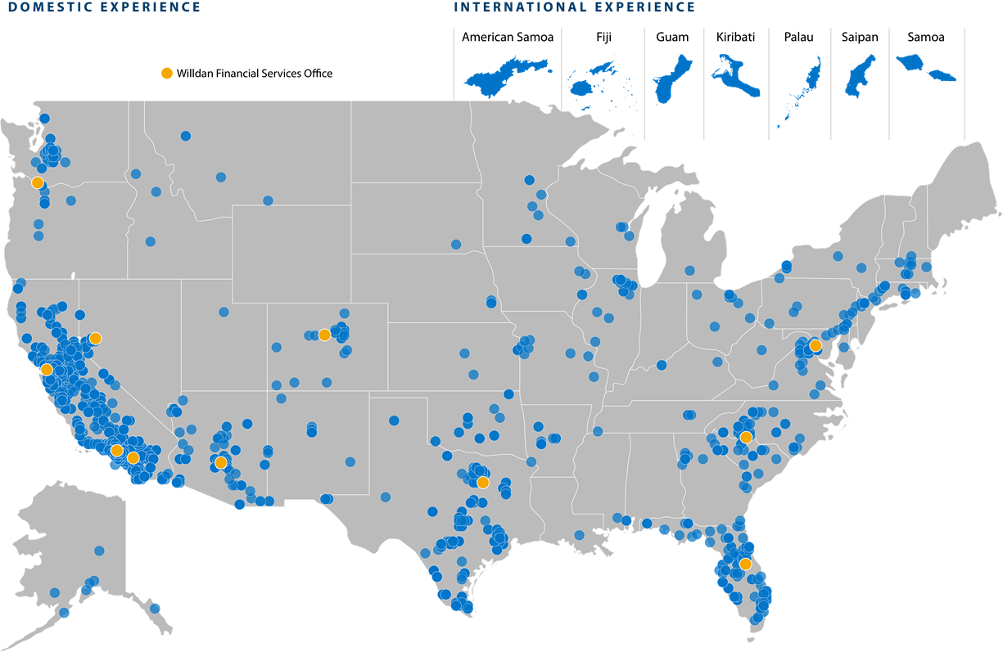
Willdan Group, Inc.
1,500⁺
Employees
Established
1964
$429M
800⁺
Annual Revenues
Public Clients Nationwide
Notes:
Molly
Willdan Financial Services is a public finance services firm of 80 staff housed within the broader umbrella of the Willdan Group, a publicly traded engineering, energy, and sustainability solutions provider. The team presenting today represents Willdan’s Real Estate and Economic Development practice, specializing in economic development strategic planning and infrastructure funding associated with population growth and real estate redevelopment.
The core team responsible for data collection, analysis, and policy recommendations have worked collectively (and in most cases jointly) in 26 US states on more than 300 market, financial feasibility and economic development-related engagements.
Willdan excels at tying together the various plans, programs, infrastructure requirements, and budgetary constraints to successfully facilitate the implementation of the community’s desired goals.

Slide 22

Willdan Financial Services
Cost Allocation and User Fee Studies | Development Impact Fees | Utility Rates
Financial and Economic Impact and Feasibility | Special District Formation and Administration (CFD, AD) | Bond Compliance (IRS and SEC)
22

Slide 23
Town of Montverde, FL
Sewer Rate Analysis

Slide 24

Rate
Sufficiency Analysis
Key Objectives
High Level Financial Analysis
  Anticipated Customers and Usage
  Current and Projected Rates
  Operating Expenses
  Liquidity targets
Projected Operating Results

Slide 25
Assumptions
Customers
  Include Willow Ridge, Apopka Sound, Hills of Montverde, Phase 1A Septic to Sewer, and Montverde Academy
  Approximately 577 retail customers in FY 2025
Average Residential billed water usage – 3,000 gallons per month
Average Montverde Academy Non-Residential water usage – 97,000 gallons per month
Average Monthly Sewer Bill
  Residential Inside Town Limits - $42
  Residential Outside Town Limits - $53
No Debt Service

Slide 26
Projected Revenue Requirements

Slide 27
Projected Operating Results
Revenues and Expenditures

Slide 28
Projected Fund Balance and Liquidity

Slide 29

Questions & Discussion
Questions?

Slide 30
CONSIDERATION OF WASTEWATER RELATED RESOLUTIONS

Slide 31
RESOLUTION NO. 2023-59
A Resolution of the Town Council of the Town of Montverde, Florida, approving the amendment to interlocal agreement for disbursement of American Rescue Plan Act funds between Lake County, Florida and the Town of Montverde to increase the funding allocation from $4,000,000 to $5,000,000 for a Sewer Infrastructure Project; providing for an effective date.

Slide 32
RESOLUTION NO. 2023-58
A Resolution of the Town Council of the Town of Montverde, Florida amending the 2022-2023 Fiscal Year budget pursuant to Section 5.05 of the Town Charter to transfer funds from general fund revenues to various general fund departments for increased expenditures in the following departments: Permitting, Legal Services, Fire Department and Capital Projects; providing for an effective date.

Slide 33
DISCUSSION ON STORMWATER PLANNING
Update on stormwater projects from Town Engineer

Slide 34

Stormwater Improvements Project Update
May 16, 2023
Notes:
Select photo and press ‘delete’ or ‘backspace’ to remove and replace with another photo

Slide 35


Project Background
Town received $1.8M in Resilient Florida Implementation Grant to be used for Montverde Infrastructure Flooding Mitigation Program
Town received a supplementary grant of $200,000 from Lake County Water Authority, to be applied toward the program
Program objectives are to construct stormwater retention/detention, collection, and control measures to mitigate flooding and nutrient runoff into Lake Florence and/or Lake Apopka). These measures can include curbing and piping that collects and diverts stormwater runoff to retention/detention ponds.

Slide 36
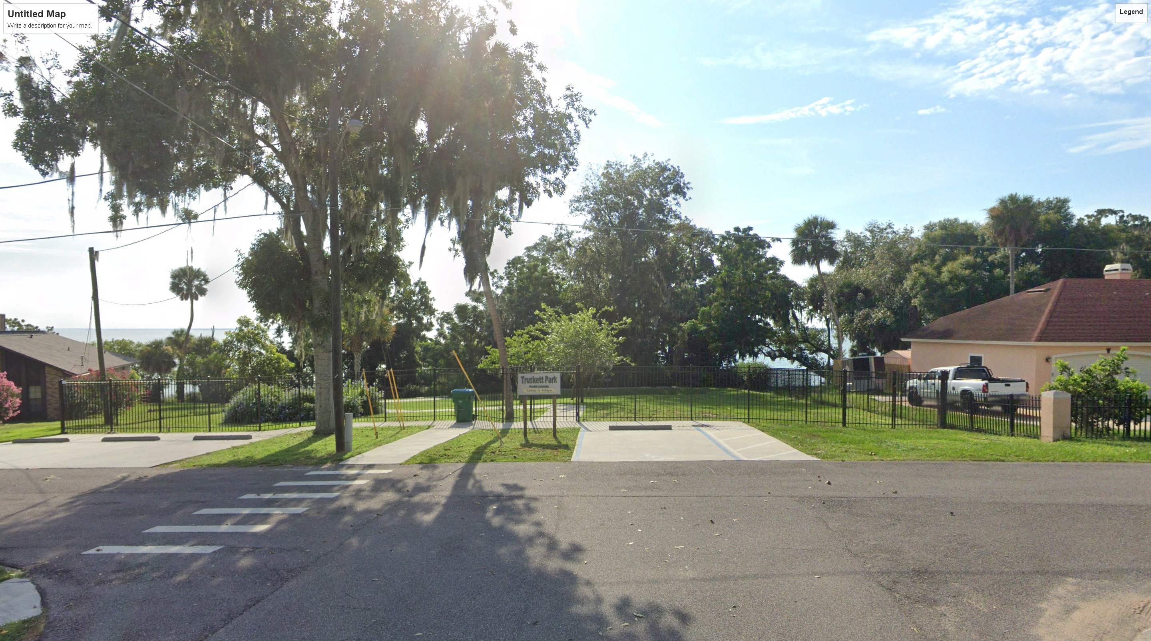
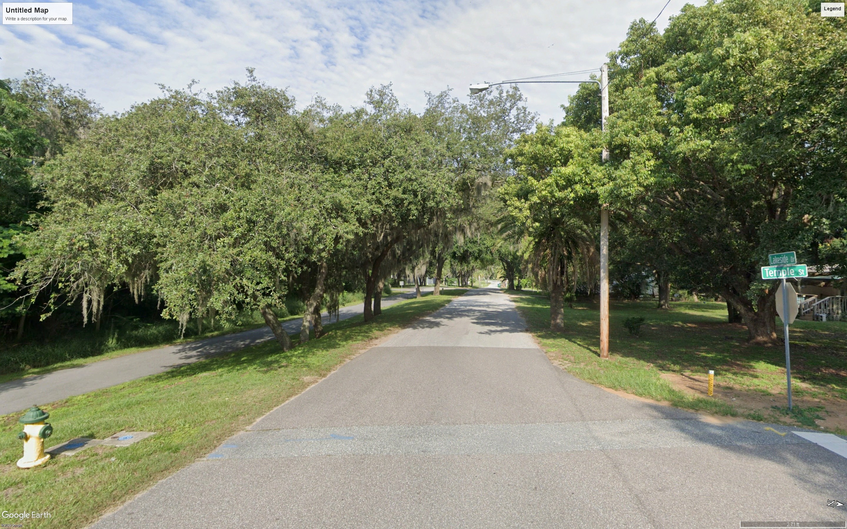
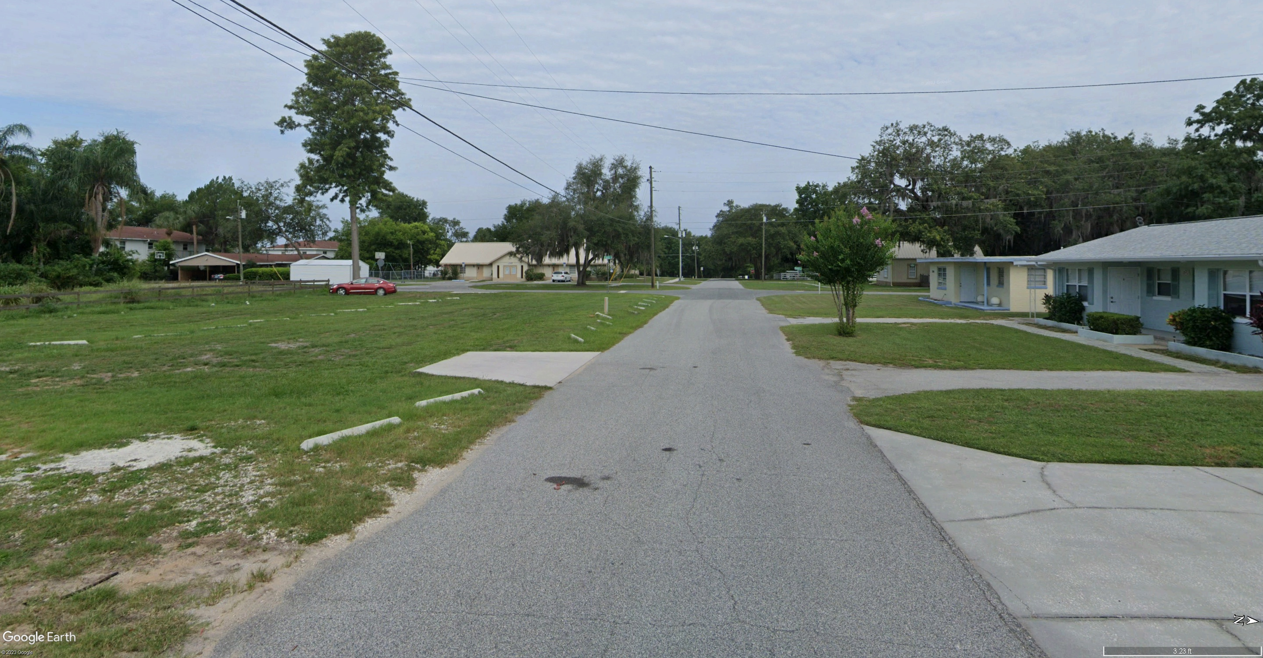
Work Completed To Date
Planning Phase (Complete)
  Field Reconnaissance, Identification and Review of SW Project Opportunities
  Preparation of Scope of Work and Projected Cost for each of the seven (7) identified SW Improvement Projects
  Review of SW Projects with City Staff and ranking of Projects based on Priority and Impact
  Based on available grant budget, the first three (3) ranked SW Projects – Truskett Park, Lakeside Drive and Downtown - were selected for Design and Construction
Design Phase (in progress)
  Survey and geotechnical Work has been completed for the three (3) Projects
  Conceptual Layout and Design Phase has started

Slide 37
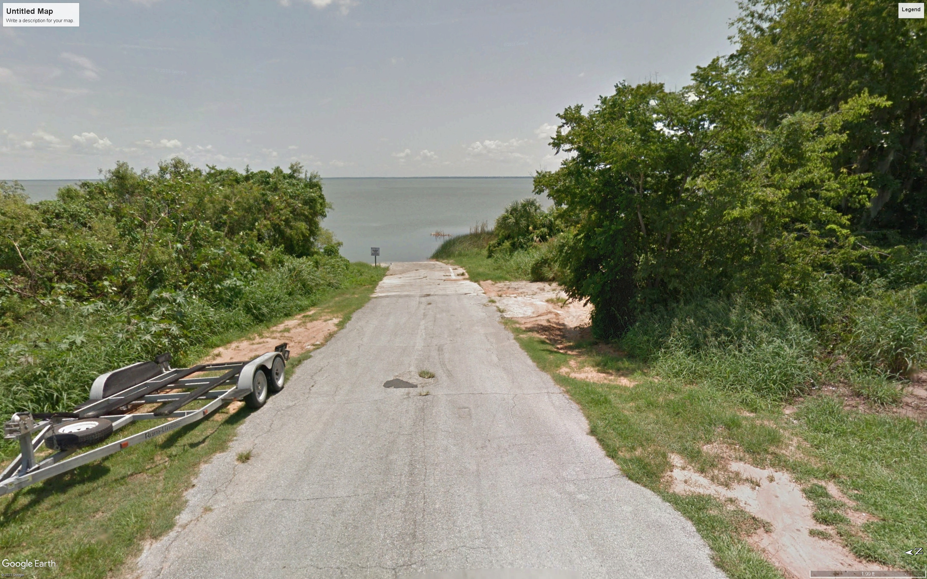
Additional Work Completed To Date
Osgood Rd./Abrams Ave. Boat Ramp Improvements
  Per City Council’s Request the Boat Ramp Improvements were added to the W&C SW Design Project
  Surveying Field Work for Boat Ramp Improvements has been completed

Slide 38
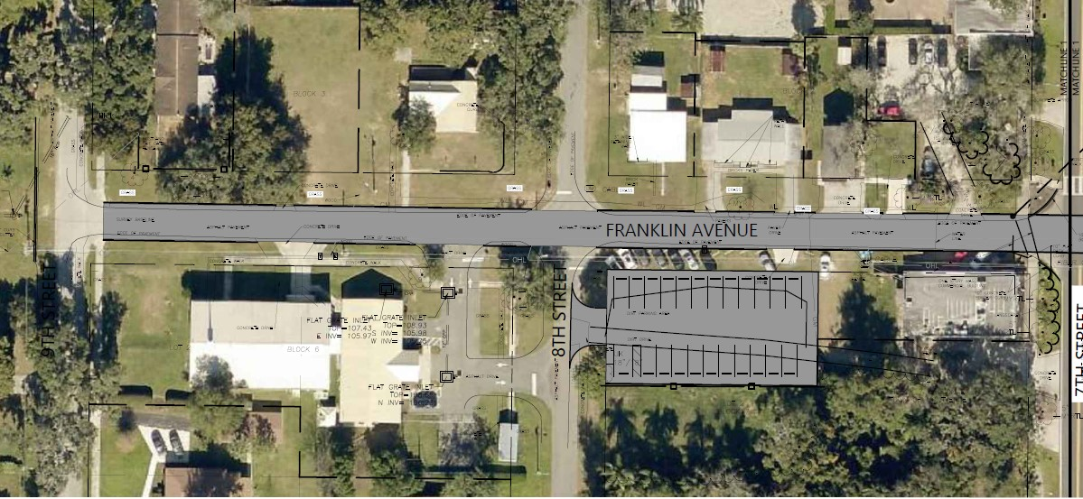
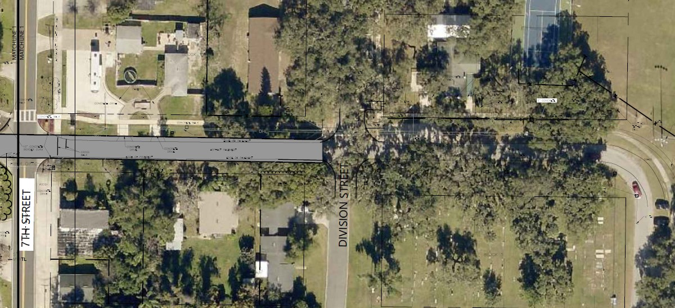
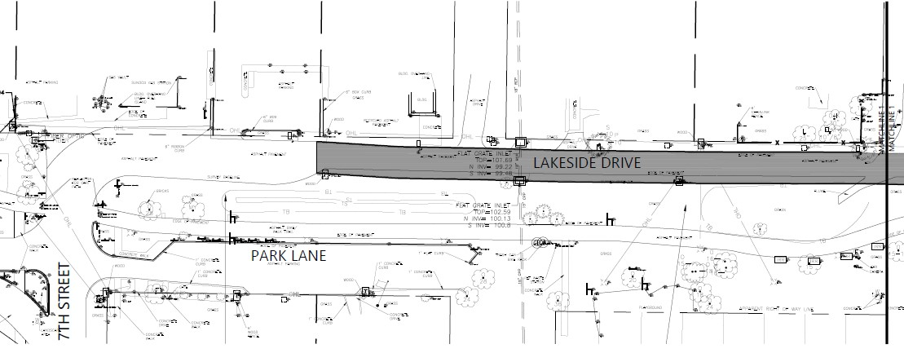
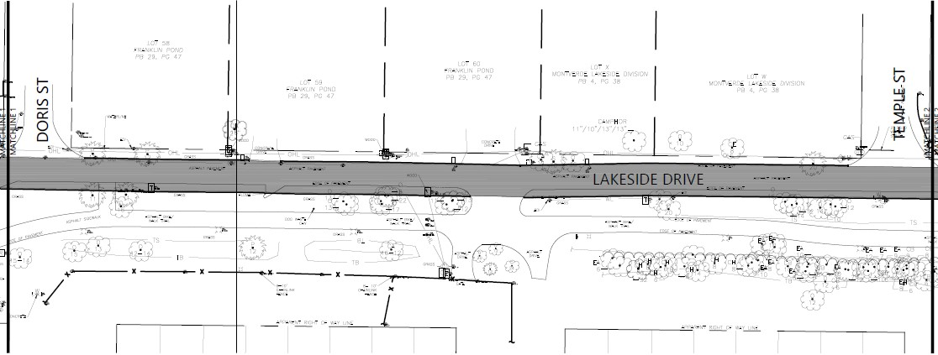
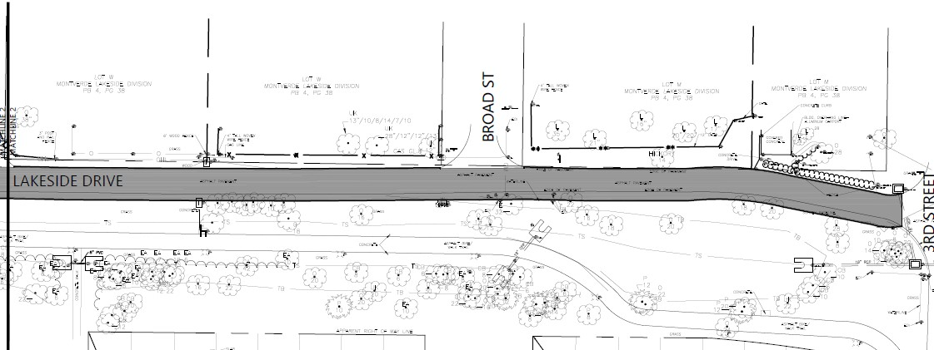
Next Steps
Osgood St/Abrams Ave. Boat Ramp Improvements
  Completion of Survey Drafting in the Week of 5/15
  Development of Specific Design and Permitting Scope
  Setup and Meeting with Water Management District about Project
  Preparation of Design Plans
Truskett Park, Lakeside Drive and Downtown SW Improvements
  Presentation of Conceptual Layouts for approval by City Staff
  Preparation of Design Plans

Slide 42
Schedule
Truskett Park, Lakeside Drive and Downtown SW Improvements
  Finalized/Approved Concepts – Mid June 2023
  60 % Plans – July 2023
  90 % Plans – August 2023
  100 % Construction Plans – September 2023
Osgood Rd./Abrams Ave. Boat Ramp Rehabilitation & SW Improvements
  Survey – Mid May 2023
  Concept Plan – TBD
  60 % Plans – TBD
  90 % Plans – TBD
  100 % Construction Plans – TBD

Slide 43
RESOLUTION NO. 2023-60
A Resolution of the Town Council of the Town of Montverde, Florida, approving the State of Florida Department of Environmental Protection Standard Grant Agreement for Montverde infrastructure flooding mitigation program, Agreement number 22FRP102 having an expiration date of September 30, 2026 in the amount of $1,800,000.00; authorizing the Town Manager to execute the agreement; providing for an effective date.

Slide 44
DISCUSSION ON POTABLE WATER PLANNING

Slide 45
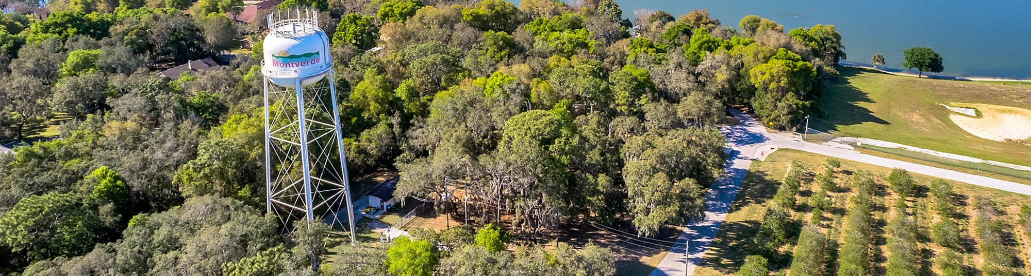
Drinking Water
SRF Facilities Plan
May 2023
Notes:
Select photo and press ‘delete’ or ‘backspace’ to remove and replace with another photo

Slide 46
The public participation process is used to explain the project and the financial impacts to the public. The public participation process shall include the project sponsor’s public meeting held before the project sponsor’s acceptance of the planning recommendations. The public meeting shall provide for public participation in the evaluation of project alternatives and shall inform the public of the capital cost of the proposed project and the long-term financial impacts on the customers. Notice of the public meeting shall be in accordance with local requirements or 14 days prior to, whichever is greater. – Chapter 62-552, F.A.C.

Slide 47
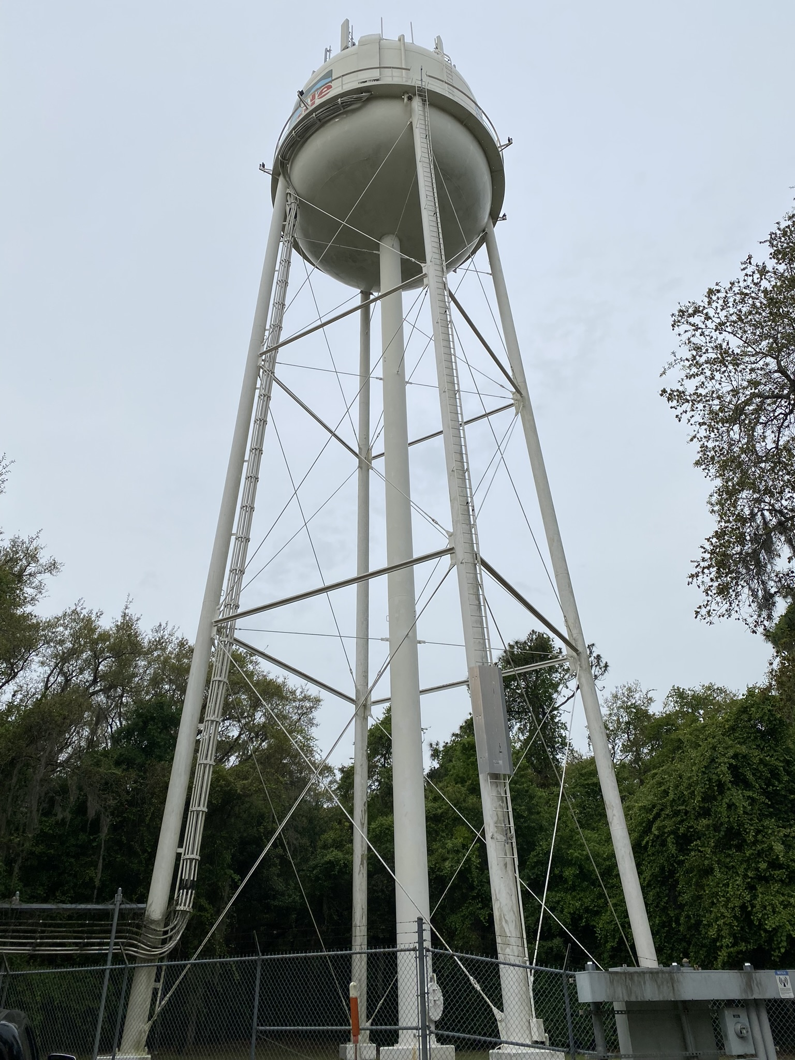
Agenda
Drinking Water Facilities Plan Review
  Project Summary
    Town needs
    Evaluation of project alternatives
    Capital cost of the proposed project
    Long-term financial impacts on the rate payer
    Estimated Schedule
  Public Comments
  Discussion by City Council
  Consideration of Resolution

Slide 48
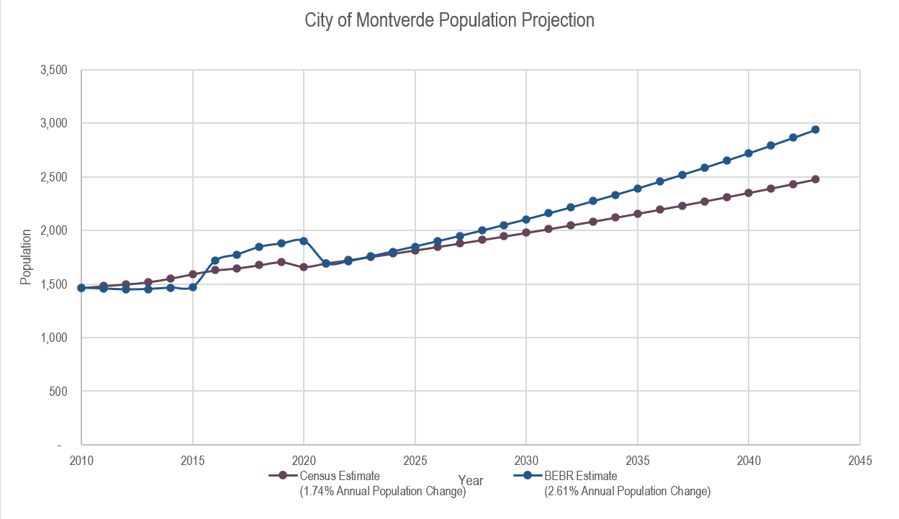
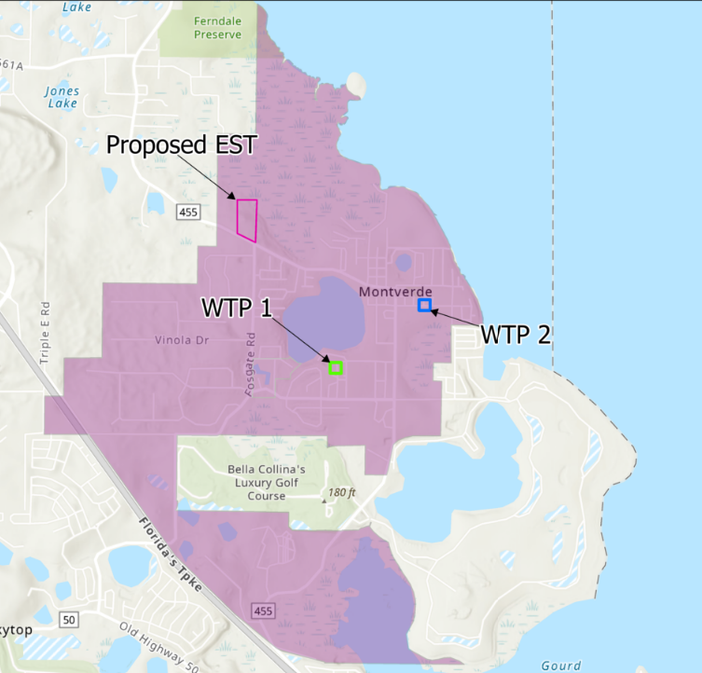
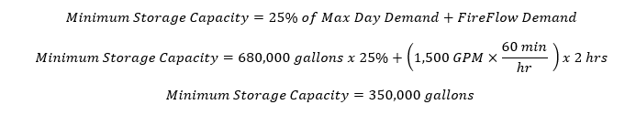
Town Needs

Slide 49

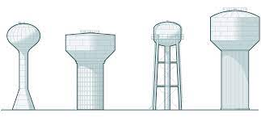
Alternatives Considered
Alternatives:
    Ground Storage + UFA Well
    Multi-Column + UFA Well
    Pedestal + UFA Well
Environmental Impacts:
  No known negative impacts are associated with the selected alternative at this time.

Slide 50
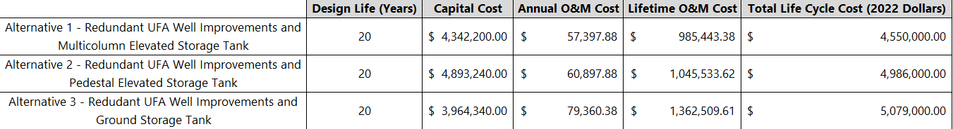
Summary of Costs
Selected Alternative Project Capital Cost:
$4,342,200
Cost to the Rate Payer:
  Current rates are sufficient to cover the projected SRF debt service for this project based on the FY 2023 town budget

Slide 51
Project Schedule
Montverde DWSRF Project Schedule
Planning Phase
 | 22-Nov | Kick-off Meeting
 | 23-Feb | 30% Design complete
 | 23-Apr | 60% Design complete
 | 23-Apr | Submit advertisement request to paper for Public Hearing
 | 23-Apr | Business Plan complete
 | 23-Apr | Environmental Review complete
 | 23-May | 90% Design Complete
 | 23-May | Advertise Public Meeting
 | 23-May | Public Meeting to discuss Facilities Plan
 | 23-May | Submit Facilities Plan Resolution, meeting minutes, and certified advertisement to SRF
 | 23-Jun | Submit draft Facilities Plan to FDEP & other government agencies
 | 23-Jun | Publication of Department’s environmental information document in the Florida Administrative Weekly
 | 23-Jun | Submit Request for Inclusion (RFI) to FDEP (Tallahassee) for design funding
 | 23-Jul | End of 30-day comment period for the environmental information document
 | 23-Jul | Approval of Planning Documents

Slide 52
Project Schedule
Montverde DWSRF Project Schedule
Design Phase
 | 23-Aug | Submit loan application to FDEP (Tallahassee) for Design Phase
 | 23-Oct | Resolution and council approval of FDEP loan agreements for design
 | 23-Oct | Complete loan agreements for design phase and release contract for design
 | 23-Nov | Project Design
 | 24-Mar | Submit plans and specifications to FDEP (Tallahassee)
 | 24-May | Submit construction permit application to FDEP (District Office)
24-May |  | Notice of intent to permit construction and project added to the priority list
 | 24-May | Submit Request for Inclusion (RFI) for inclusion of the construction to FDEP’s project priority list;
Construction Phase
 | 24-Sep | Hearing to add project to the Fundable portion of the priority list;
 | 24-Oct | Submit loan application to FDEP (Tallahassee) for construction activities;
 | 24-Oct | Resolution and council approval of FDEP loan agreements for construction;
 | 24-Dec | Complete loan agreements for construction activities;
 | 25-Jan | Advertise for bids;
 | 25-Feb | Open construction bids;
 | 25-Feb | Award contract;
 | 25-Mar | Issue a notice to proceed (NTP) to Start project construction:
 | 25-Dec | Complete construction of the project;
 | 26-Jan | Certify operation performance of the project and close out the project; and
 | 26-Jun | Begin SRF loan repayments to FDEP

Slide 53
Drinking Water Facilities Plan
Technical Review
Environmental Review
Financial Review
Project Schedule
Public Comments
City Council Discussion
Consideration of Resolution

Slide 54
THANK YOU!
May 2023
Notes:
Select photo and press ‘delete’ or ‘backspace’ to remove and replace with another photo

Slide 55
Resolution No. 2023-55
A Resolution of the Town Council of the Town of Montverde, Florida, relating to the Florida Department of Environmental Protection (FDEP) State Revolving Fund (SRF), adoption of the Drinking Water Facility Plan for the implementation of Drinking Water Improvements, effective this date.

